Slide 1


I SEE YOU.
I SEE YOUR SUFFERING.
YOU ARE MY SISTER.
Christian women around the world are doubly at risk of persecution because of their faith and gender. But the form of persecution experienced by Christian women often go unseen. House arrest happens behind closed doors, and the shame associated with forced marriage and sexual abuse mean that these crimes go unreported.
We, the worldwide family of God, cannot allow the persecution facing our sisters to go unseen and ignored. Open doors has launched the See. Change. campaign to restore women's hope, dignity and identity. Our vision is that every women who is persecuted for her faith and gender is seen, valued and empowered to reach her God-given potential. You can help make that vision a reality with you long-term support, prayers and actions.

Slide 2
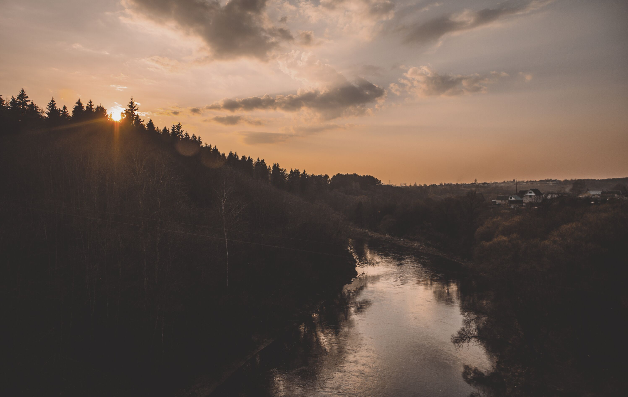

I HEAR YOU.
ALL:
I respond with my support and my prayers, knowing that God hears us too.

